Slide 1
FinEdge - Financial Planning Assistant chatbot
CAPSTONE PROJECT
Presented By:
Uppalapati Venkata Ashok Adithya

Slide 2
OUTLINE
Problem Statement (Should not include solution)
Proposed System/Solution
System Development Approach (Technology Used)
Result
Conclusion
Future Scope
References

Slide 3
Problem Statement
Develop a financial planning chatbot that engages users in natural language conversations to manage their finances and achieve their goals. The chatbot will securely collect financial information, offer accurate advice on budgeting, saving, investing, and retirement planning, and provide step-by-step guidance. It will include a feedback mechanism for continuous improvement of its performance and user experience.

Slide 4
Proposed Solution
User Interaction: The chatbot engages users in natural language conversations, using prompts and responses to guide them through the financial planning process.
Information Collection: It prompts users to input their name, contact information, financial goals, income details, and current savings, securely storing this information.
Query Handling: The chatbot responds to inquiries about budgeting, savings plans, investment options, retirement planning, and tax strategies with accurate and helpful responses.
User Guidance: It provides step-by-step guidance on how to achieve financial goals, including creating budgets, selecting investment options, and planning for retirement.
Feedback Mechanism: The chatbot incorporates a feedback mechanism to improve its responses and user experience over time, ensuring continuous optimization.

Slide 5
System Approach
The "System Approach" section outlines the overall strategy and methodology for developing and implementing the financial planning chatbot. Here's a suggested structure for this section:
System requirements: Windows 10 operating system , 8GB RAM, I5 Processor
Library required to build the model: IBM Watsonx assistant

Slide 6
Result
Develop a financial planning chatbot that engages users in natural language conversations, securely collects essential financial information, and provides accurate responses to queries about budgeting, saving, investing, and retirement planning. It offers step-by-step guidance to help users achieve their financial goals and includes a feedback mechanism for continuous improvement.

Slide 7
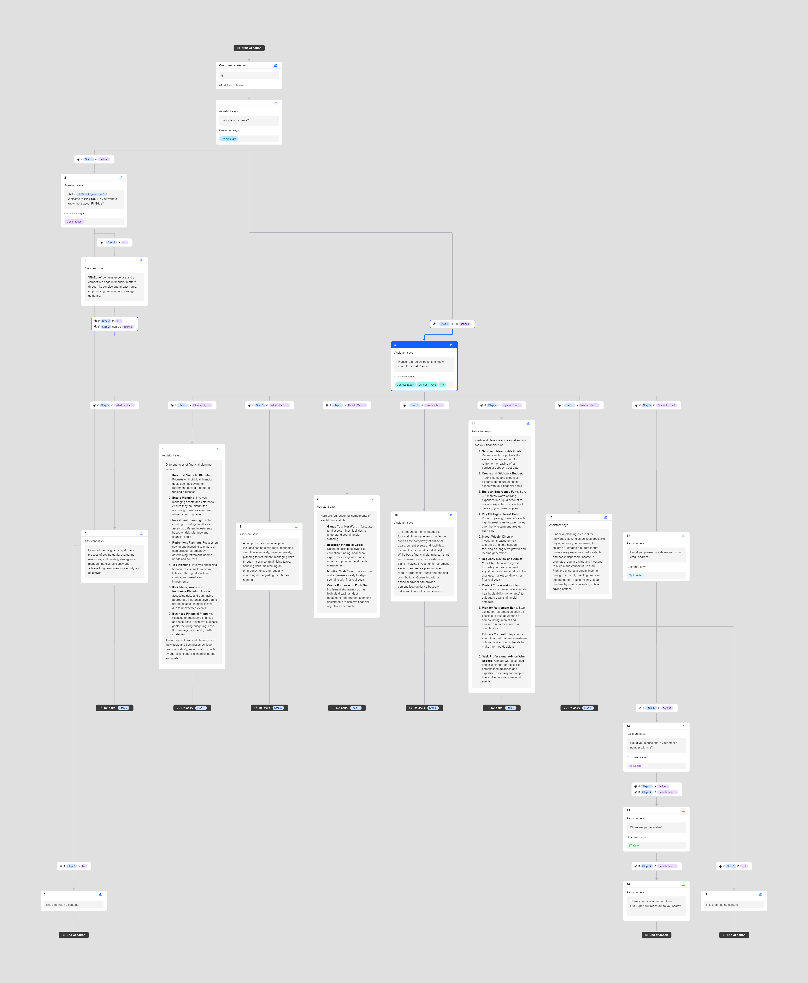
Result

Slide 8
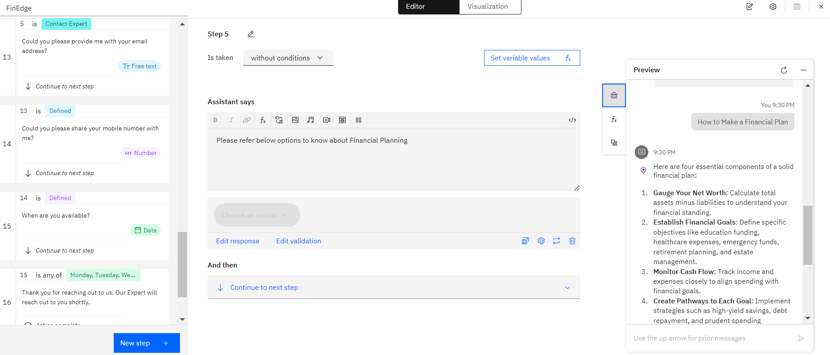
Result

Slide 9
Ibm WATSONX ASSISTANT – CHATBOT LINK
https://web-chat.global.assistant.watson.appdomain.cloud/preview.html?backgroundImageURL=https%3A%2F%2Fau-syd.assistant.watson.cloud.ibm.com%2Fpublic%2Fimages%2Fupx-96a31514-1479-4837-b8a2-faf7fdc1e686%3A%3A47728b44-ba31-4dec-bdde-30f51a79c69b&integrationID=9b83923f-a7a6-49e1-b244-a5165752b677&region=au-syd&serviceInstanceID=96a31514-1479-4837-b8a2-faf7fdc1e686

Slide 10
Conclusion
In conclusion, the development of a robust financial planning chatbot offers users a seamless and personalized approach to managing their finances. By engaging users in natural language interactions, securely collecting and analyzing financial data, and providing tailored advice on budgeting, saving, investing, and retirement planning, the chatbot aims to empower individuals to achieve their financial goals effectively. Incorporating continuous feedback mechanisms ensures the chatbot evolves to meet the dynamic needs of users, enhancing overall satisfaction and financial management outcomes.

Slide 11
Future scope
Personalized Financial Insights: Integrating machine learning algorithms to analyze user financial behaviors and preferences, offering customized financial recommendations and tailored assistance for better financial planning outcomes.
Enhanced Accessibility: Implementing multilingual support to make the chatbot accessible to a broader audience, ensuring inclusivity and accommodating diverse financial needs and preferences.
Interactive Financial Education: Introducing interactive modules for financial education and workshops within the chatbot, empowering users with knowledge on budgeting, investing, and financial literacy.
Integration with IoT Devices: Exploring integration with IoT devices to provide real-time financial monitoring and alerts, enhancing user engagement and proactive financial management capabilities.
Blockchain for Security: Leveraging blockchain technology to enhance data security and transparency, ensuring safe handling of sensitive financial information and building user trust.

Slide 12
References
IBM watsonx Assistant tutorial

Slide 13
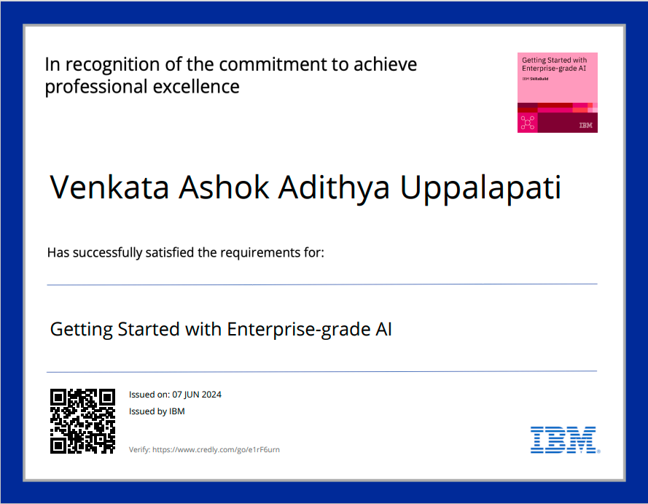
course certificate 1

Slide 14
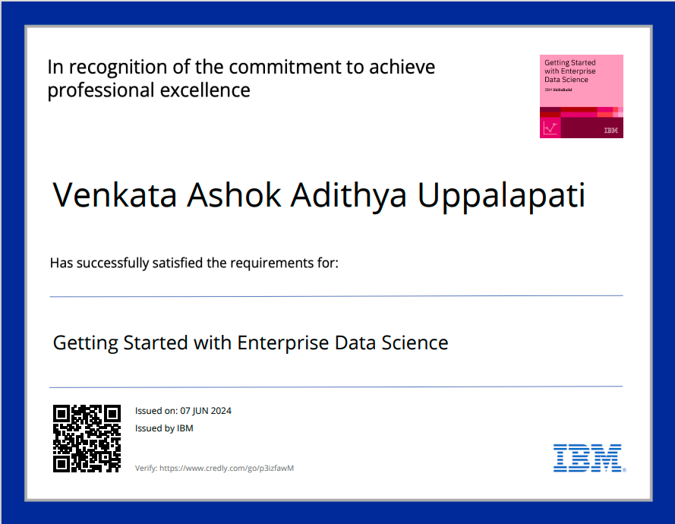
course certificate 2

Slide 15


